Slide 1
Spine Biopsy

Slide 2
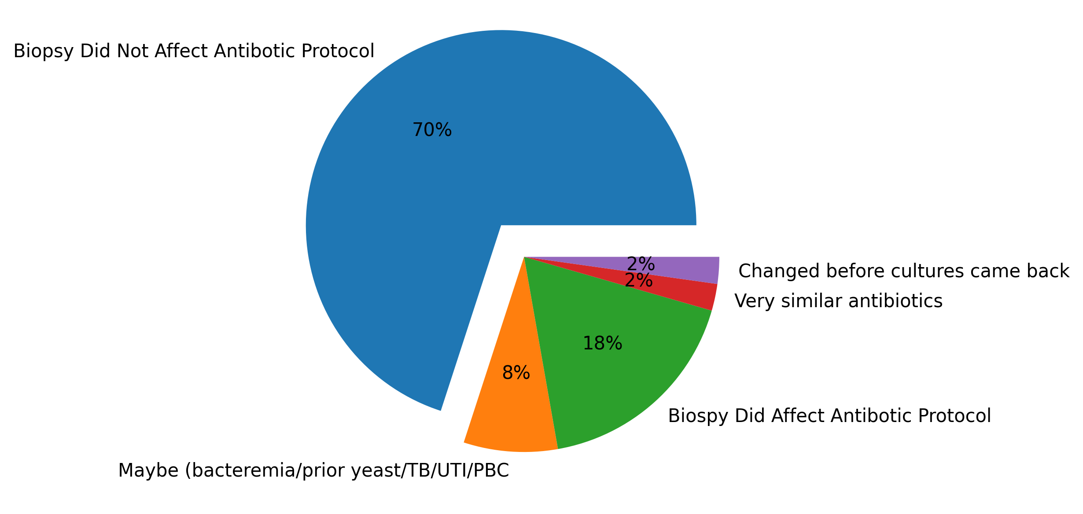
Did the biopsy affect the antibiotic course?
An astonishing 70% of the patients did not change their antibiotic protocol after their biopsy.
What other factors are playing a role in the efficacy of the biopsy?

Slide 3
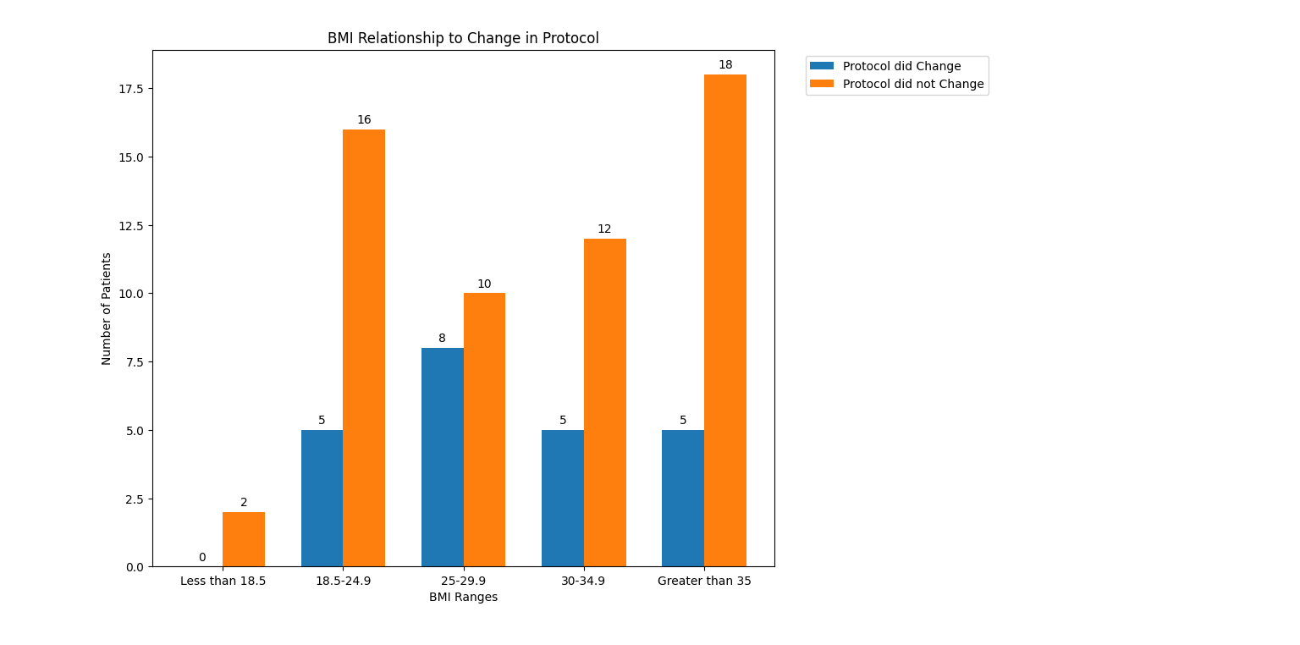
Does BMI affect whether the biopsy affected the antibiotic course?
Average BMI of those who had a change in protocol is 30.15.
Average BMI of those who did not have a change in protocol is 31.19.
L00ks like nawght,
Bmi range 25-29.9 is worth looking at.

Slide 4
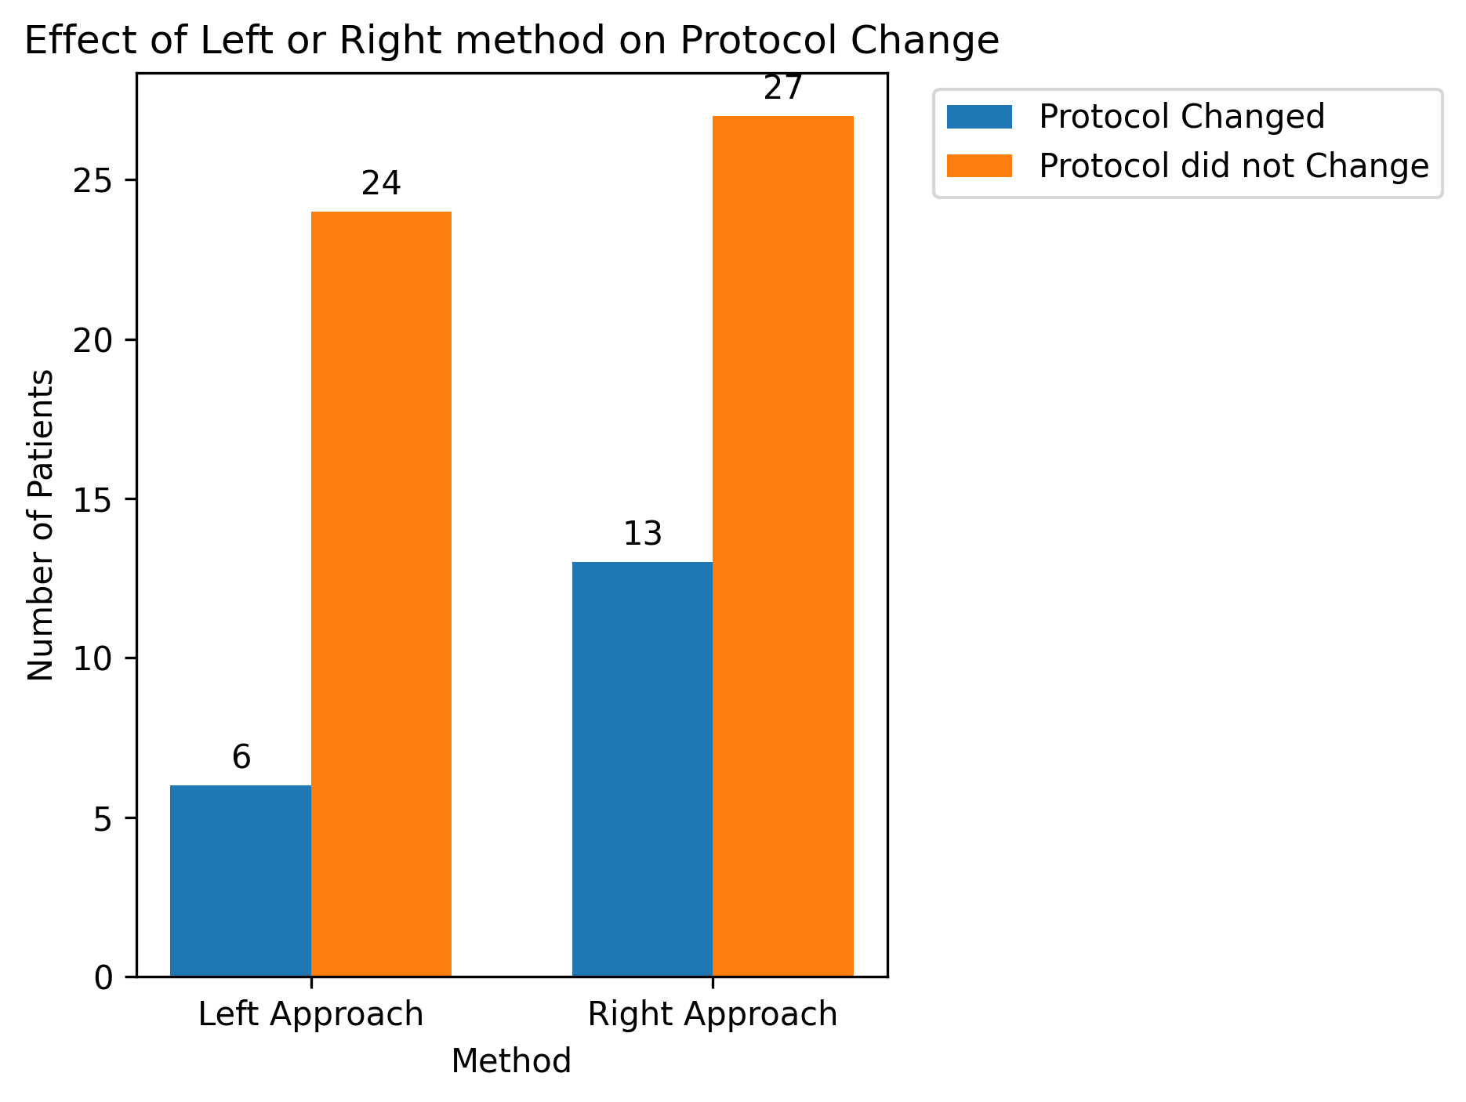
Does right or left approach affect whether the biopsy affected the antibiotic course?
Note: 2 patients from left approach and 2 patients from right approach were all placed on very similar antibiotics post biopsy procedure.

Slide 5
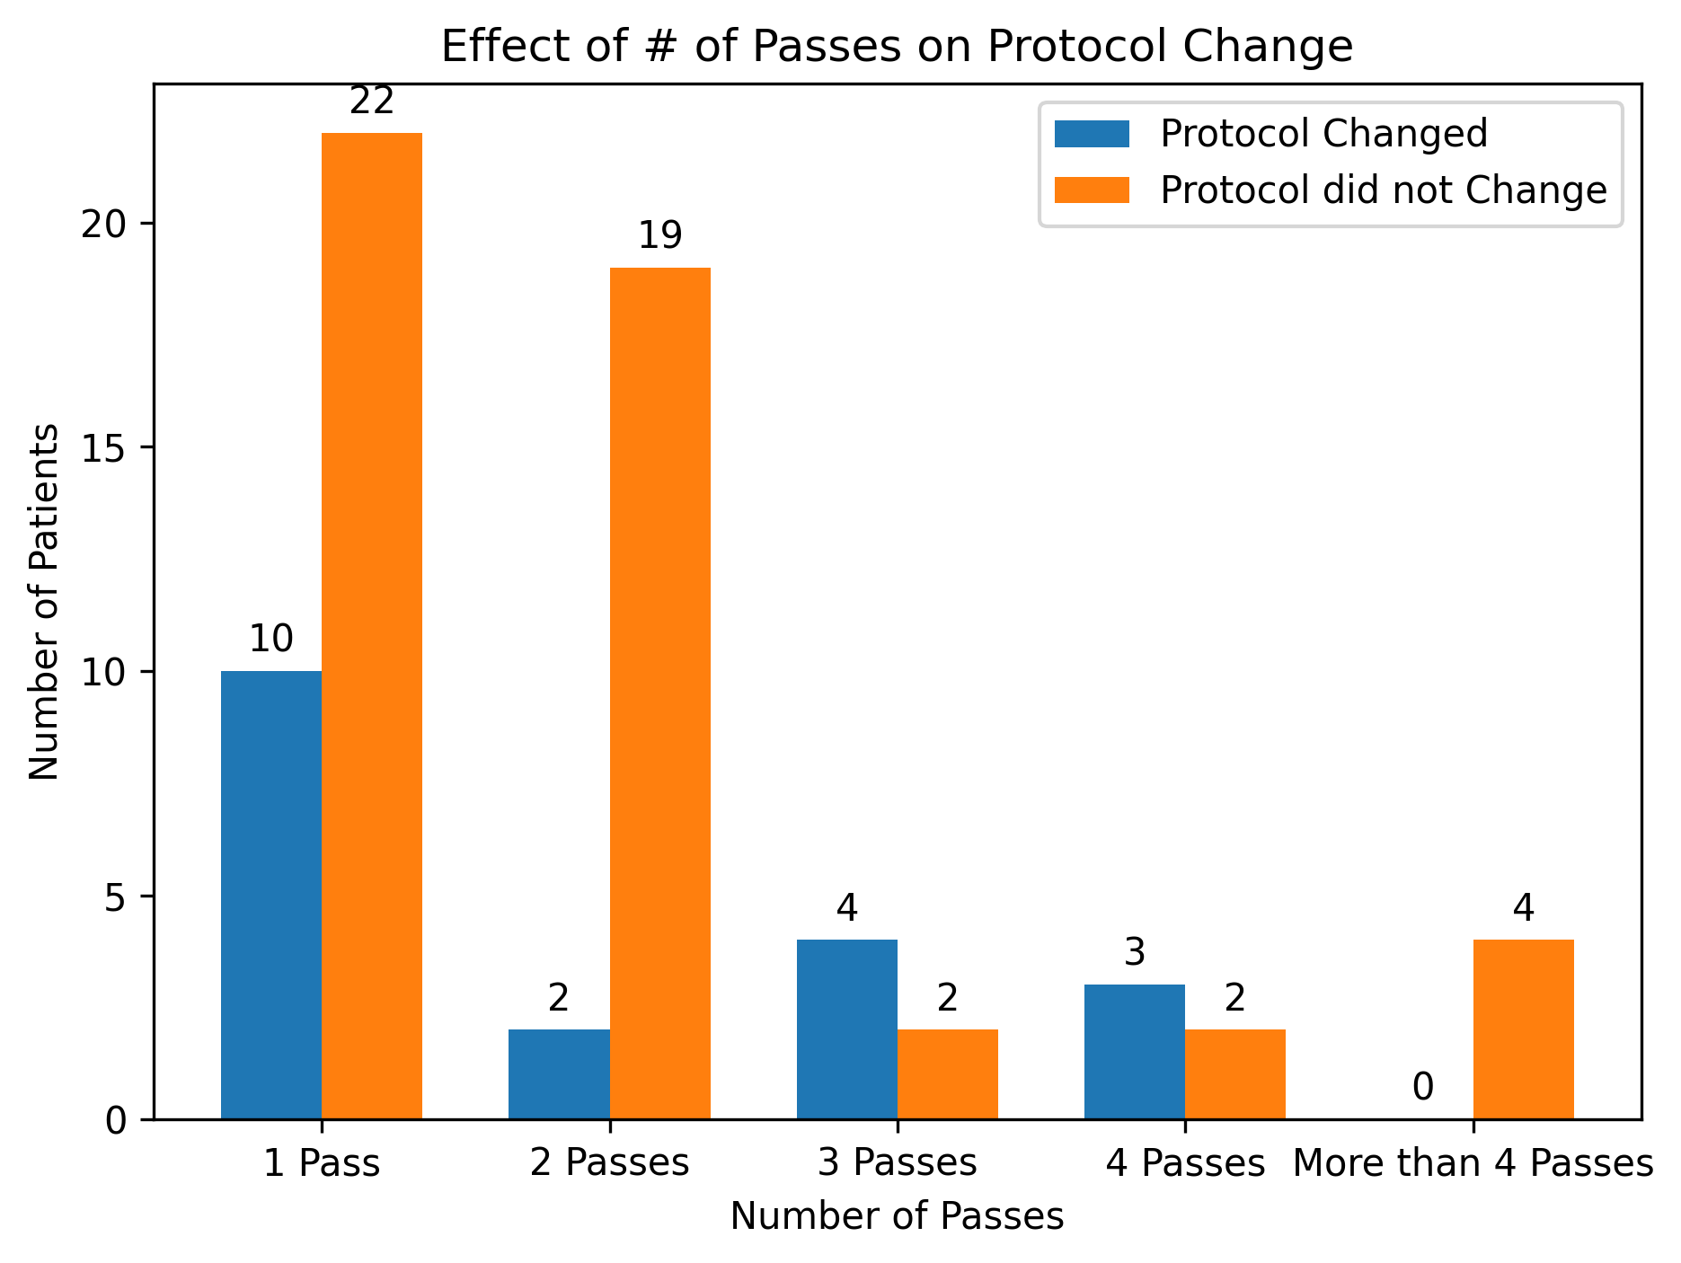
Does the number of passes affect whether the biopsy affected the antibiotic course?
Balls
Balls

Slide 6
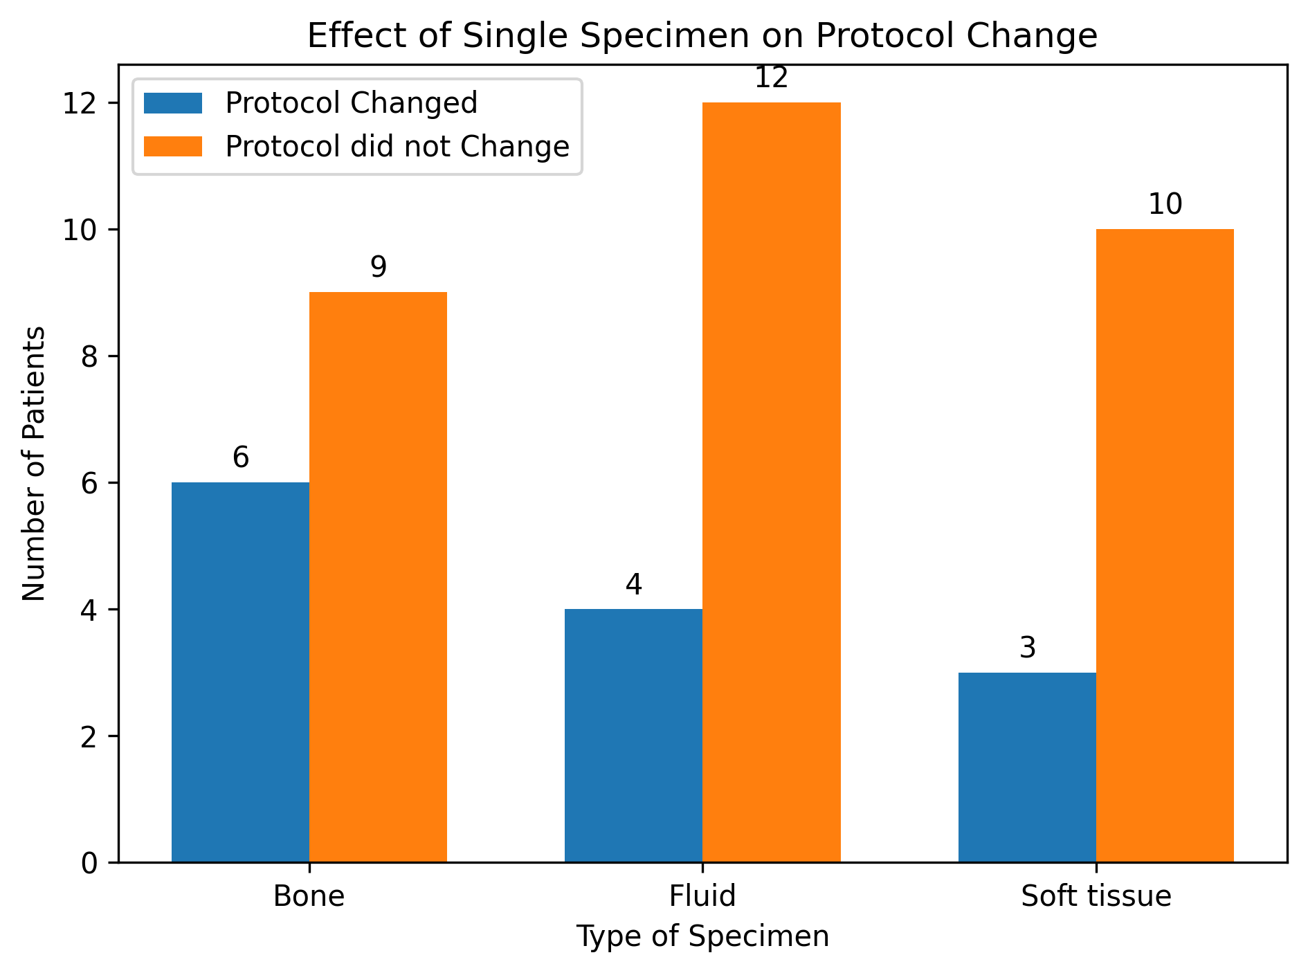
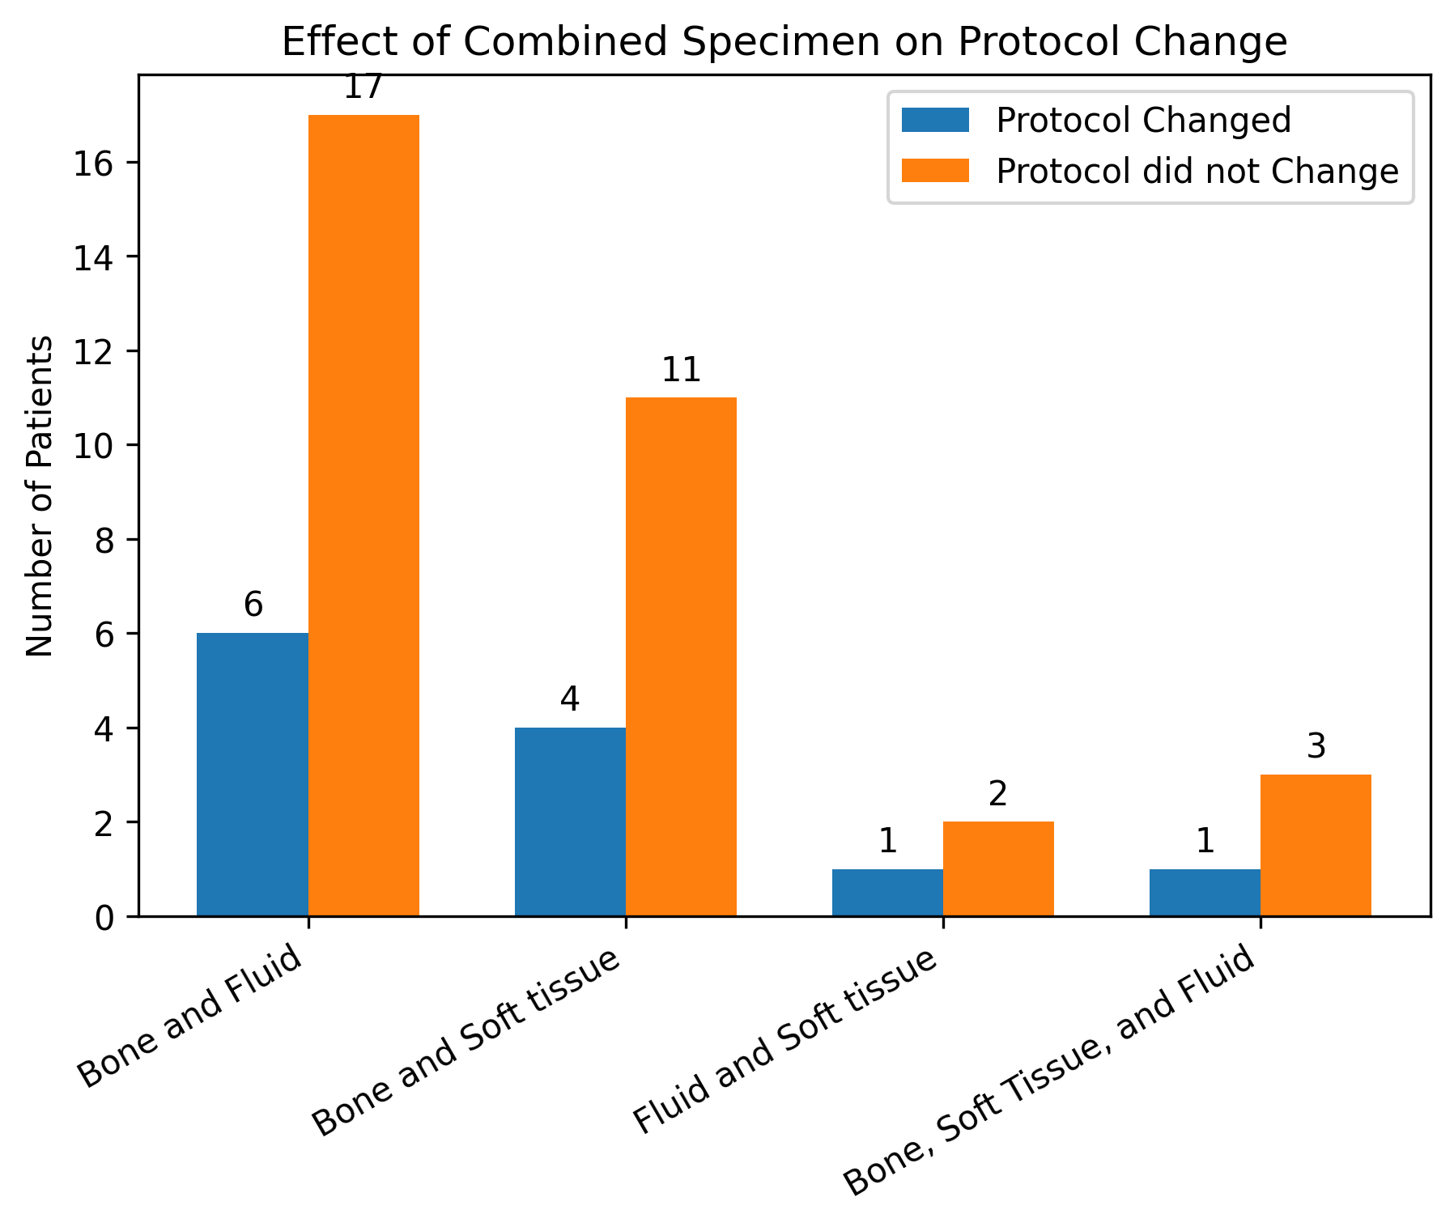
Does the type of specimen obtained (bone, disc, soft tissue, etc) affect whether the biopsy affected the antibiotic course?

Slide 7
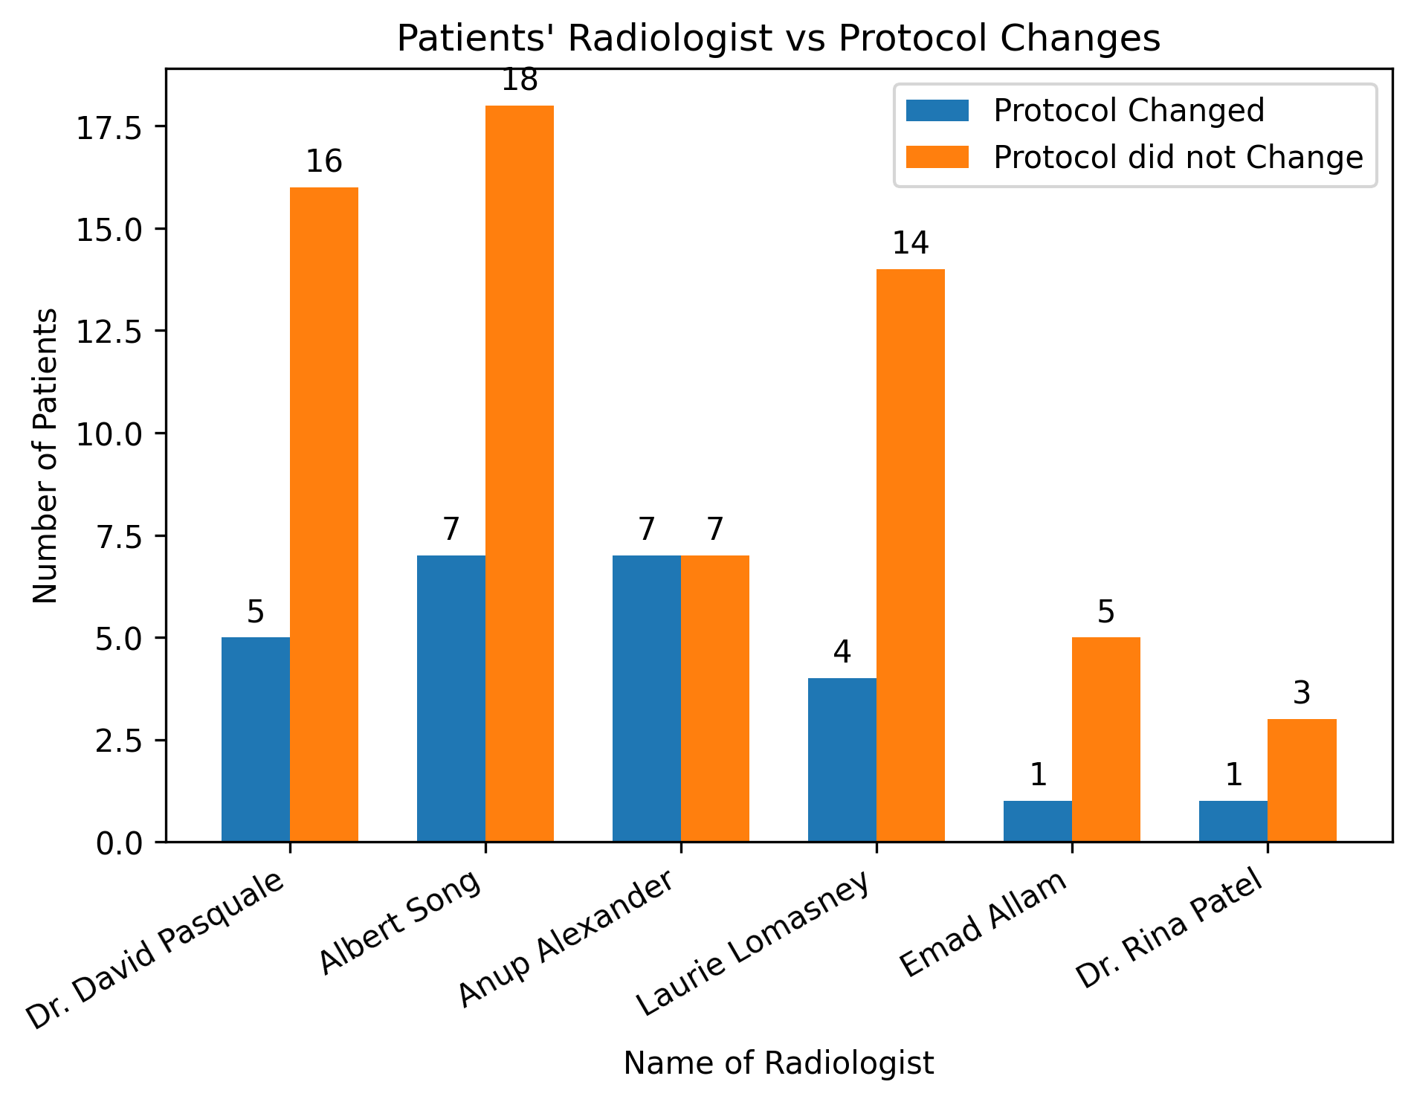
Does the name of the Radiologist who performed the procedure affect whether the biopsy affected the antibiotic course?
Note: Andrew Chiang had one patient change their protocol and one patient not change their protocol.
Dr. Himanshu Patel and David Pasquale each had one patient that did not change their protocol.
Anup Alexander was the only radiologist to have an even split between changes in protocols.

Slide 8
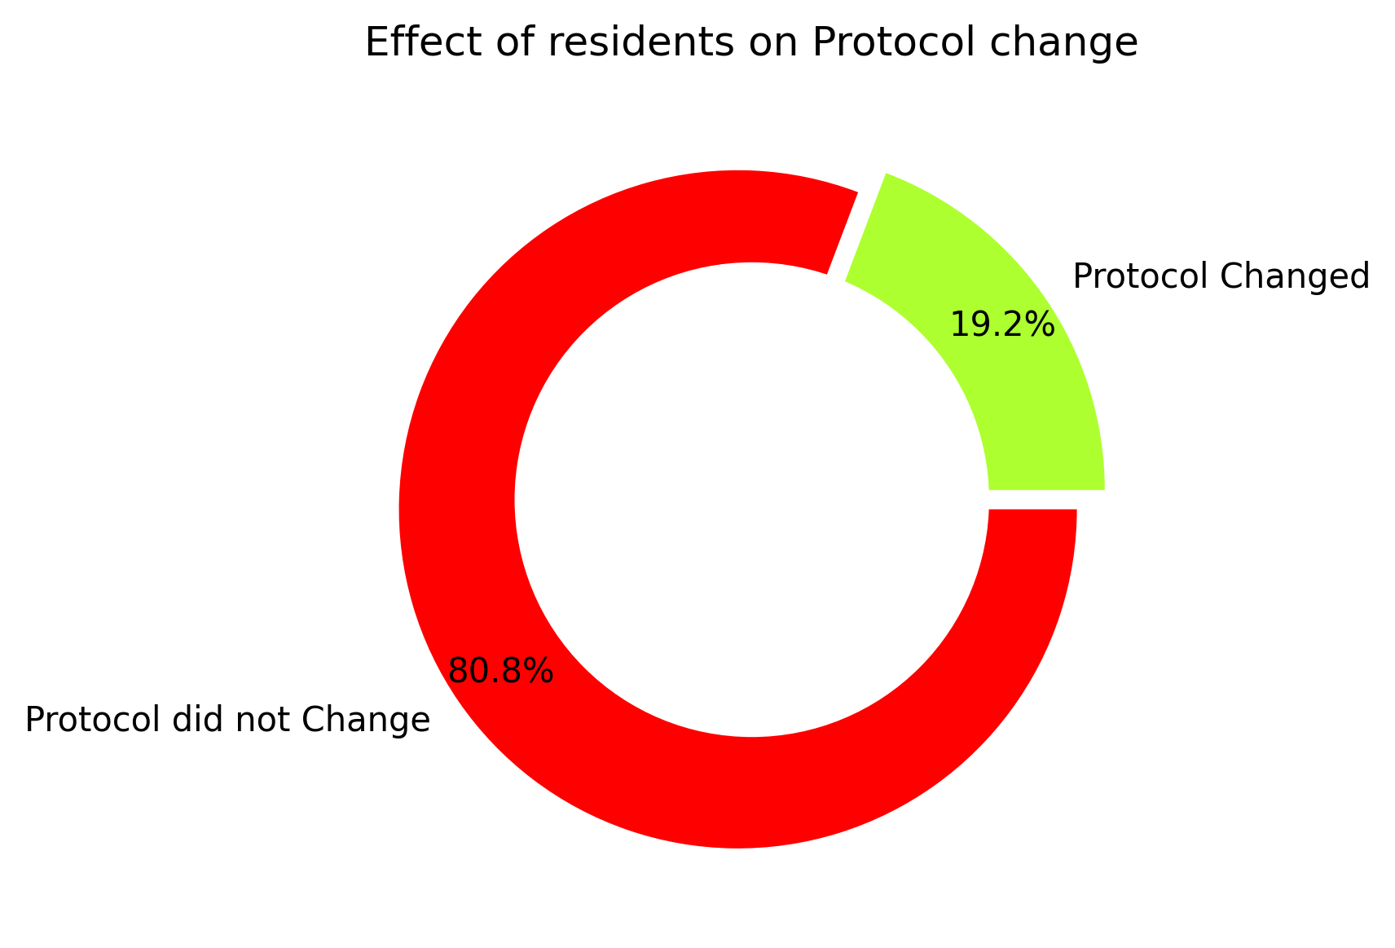
• Does the involvement of a resident affect whether the biopsy affected the antibiotic course?

Slide 9
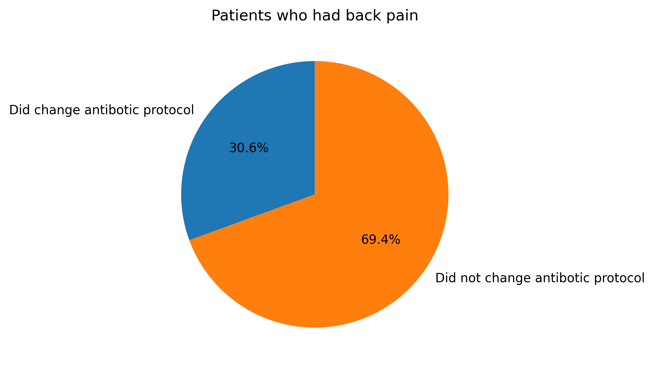
Does the presence of back pain increase odds of a positive or negative biopsy result?
Note:
Only 4 out of 92 patients did not have back pain.
All 4 patients did not change their antibiotic protocol after their biopsy.

Slide 10
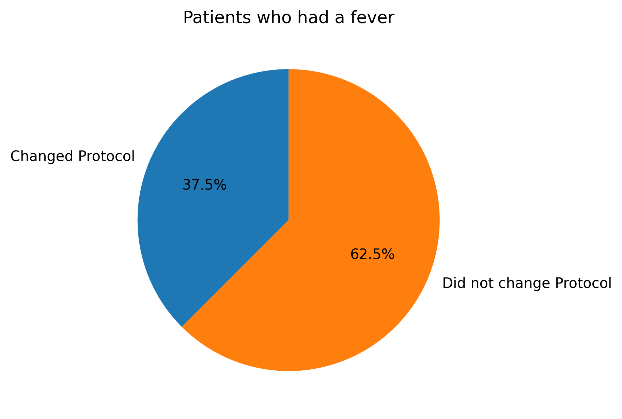
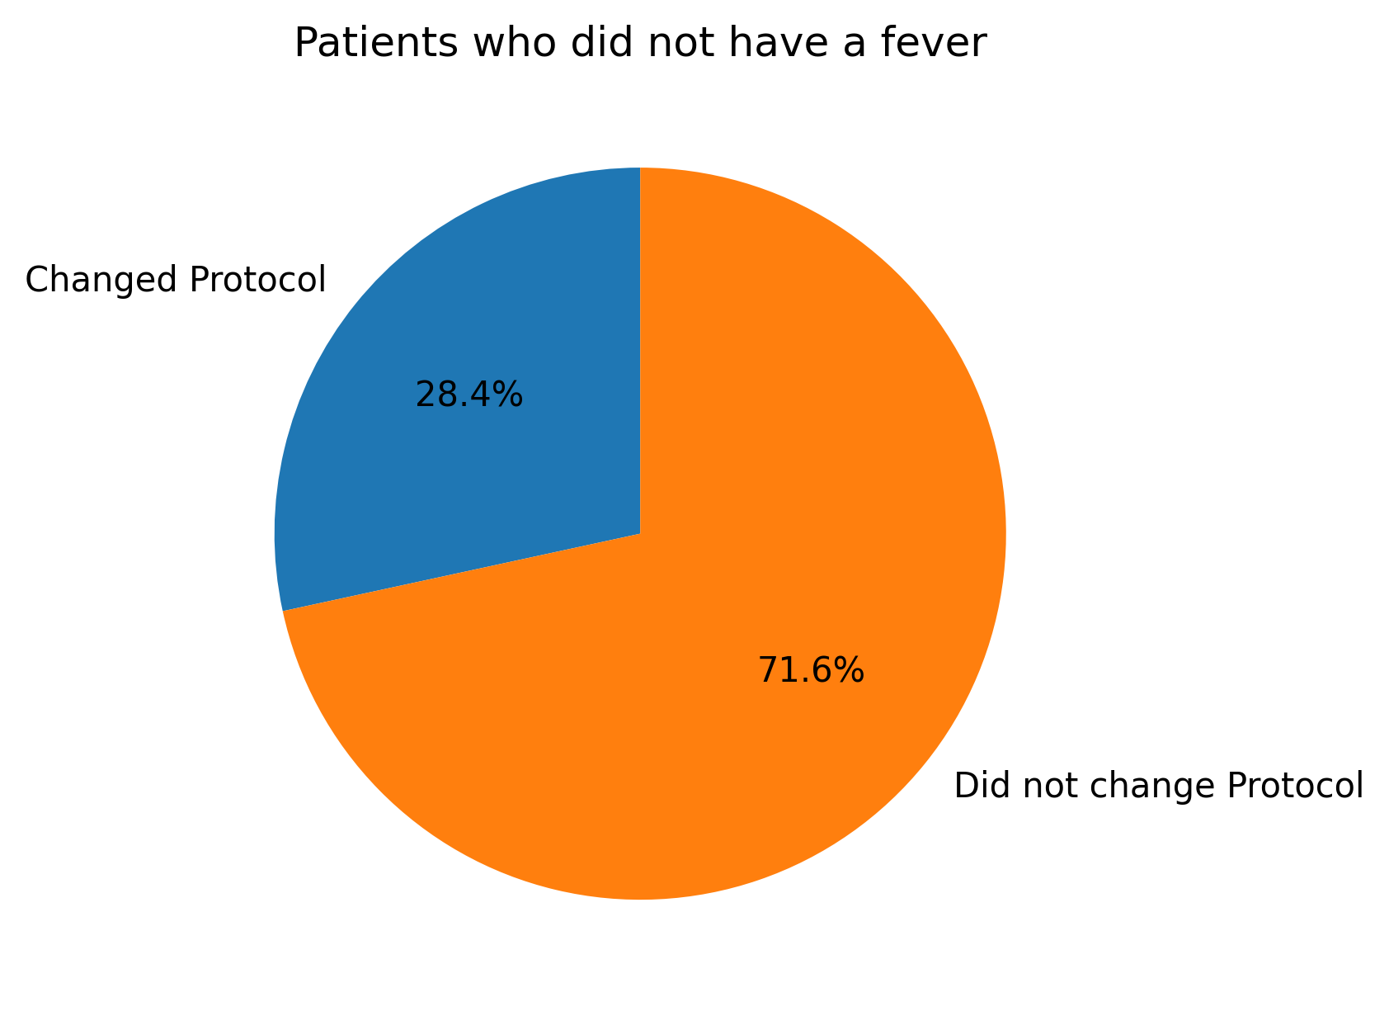
Does the presence of fever increase odds of a positive or negative biopsy result?
Note: only 8 patients had a fever. 3 of them changed their protocol and 5 of them did not.

Slide 11
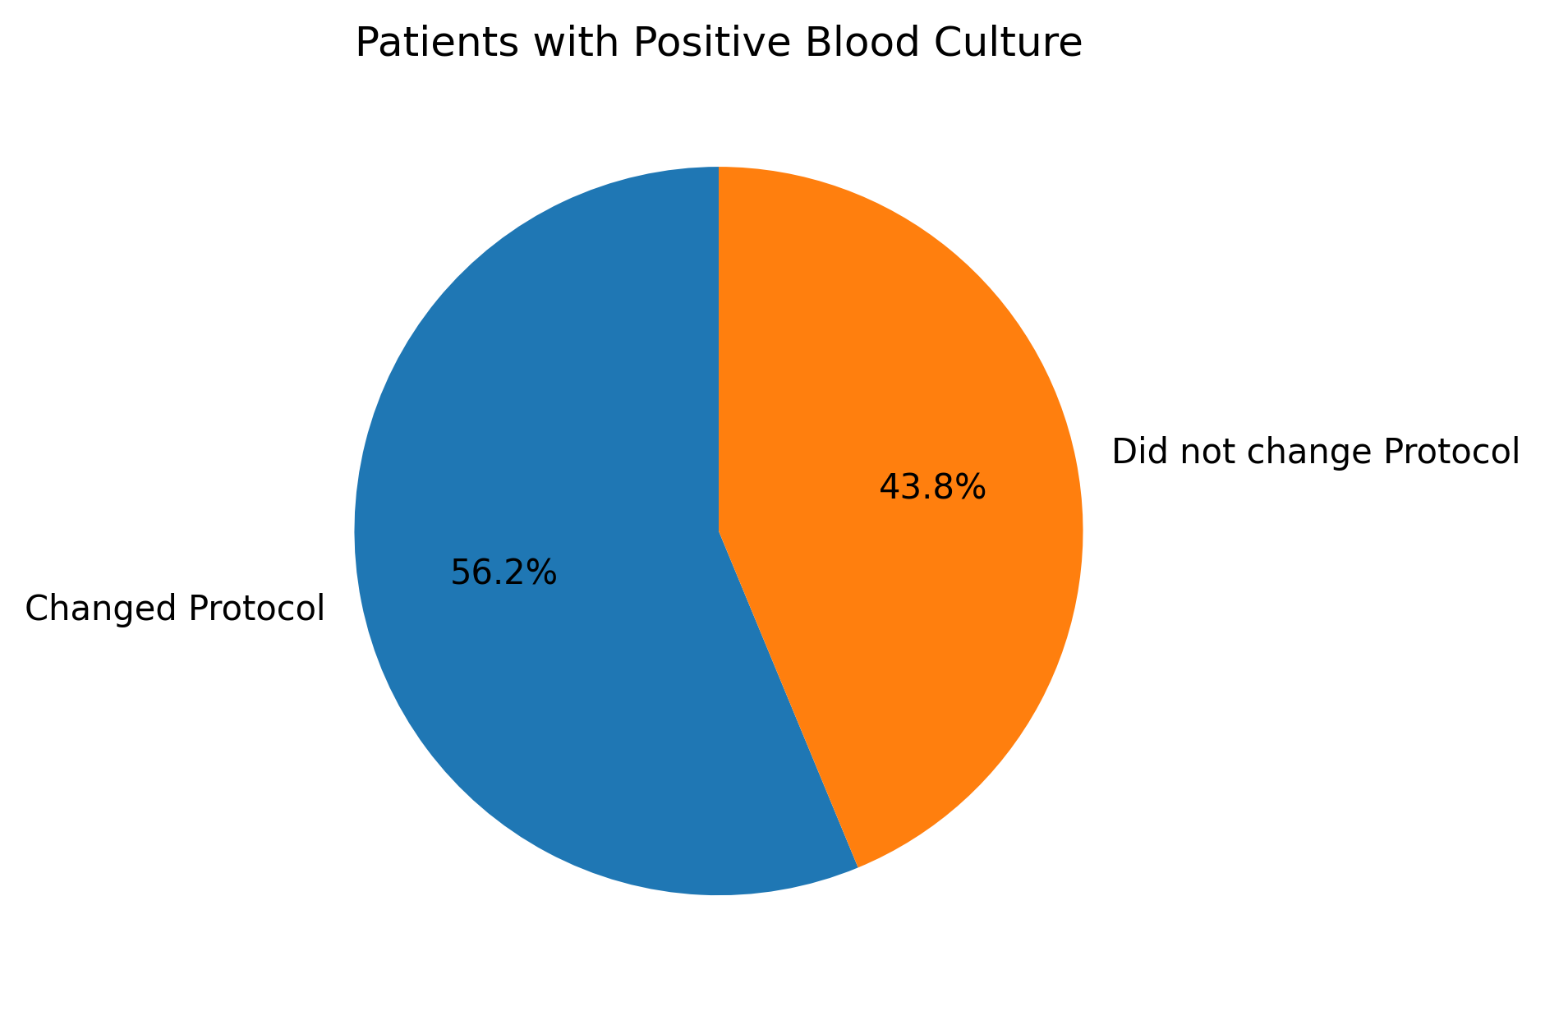
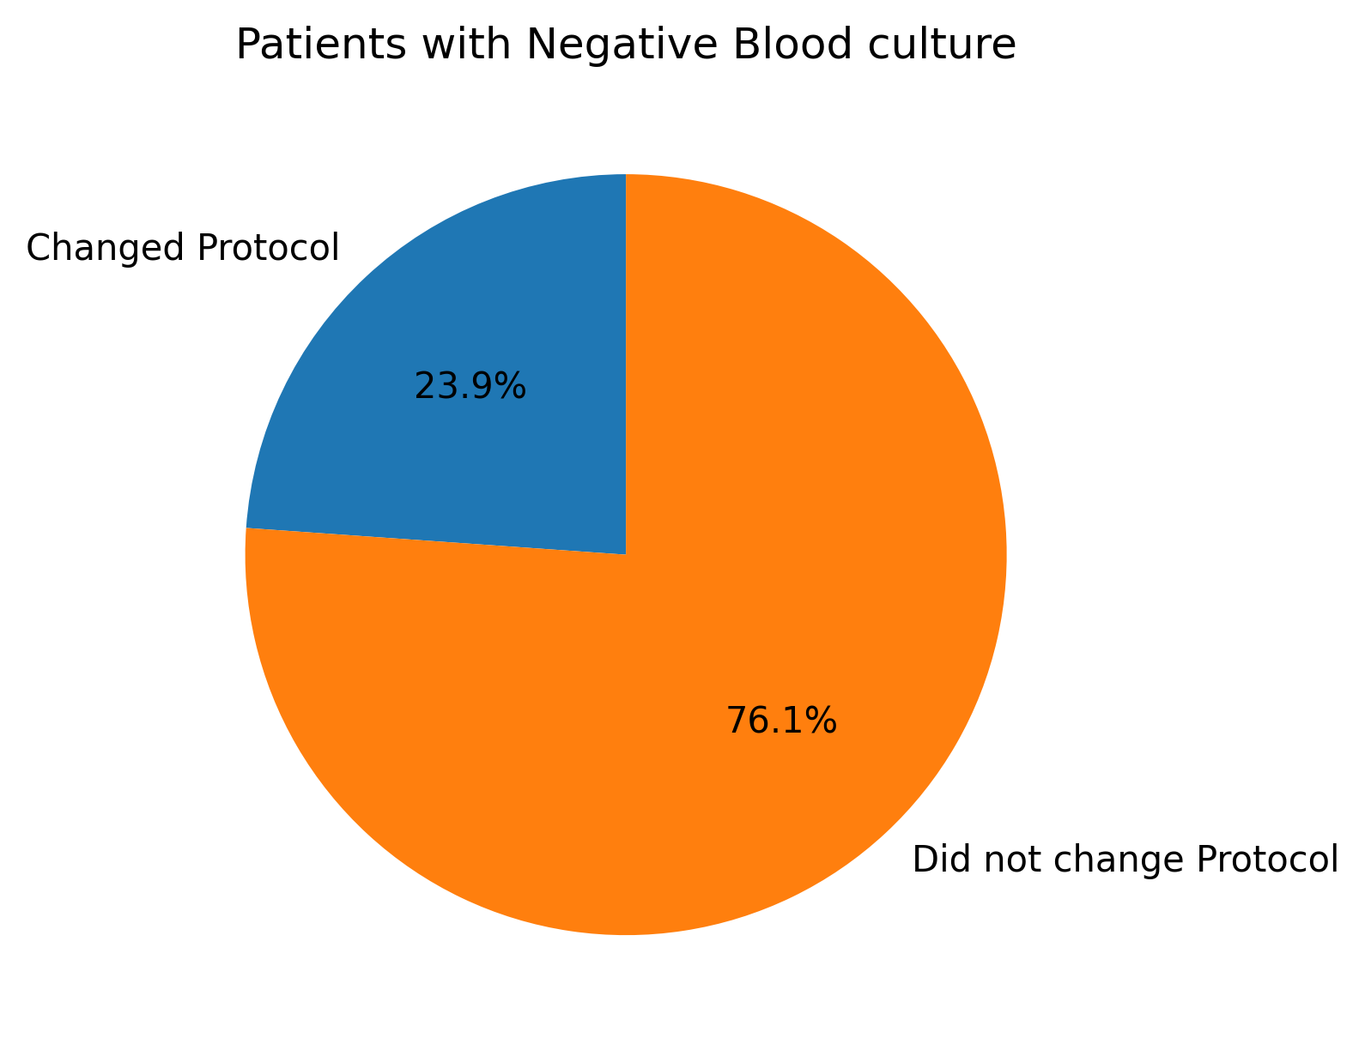
Does a positive blood culture affect the whether the biopsy affected the antibiotic course? *Important/interesting slide*
^^^^LOOKIE LOOKIE WHAT DO WE HAVE HERE????????

Slide 12
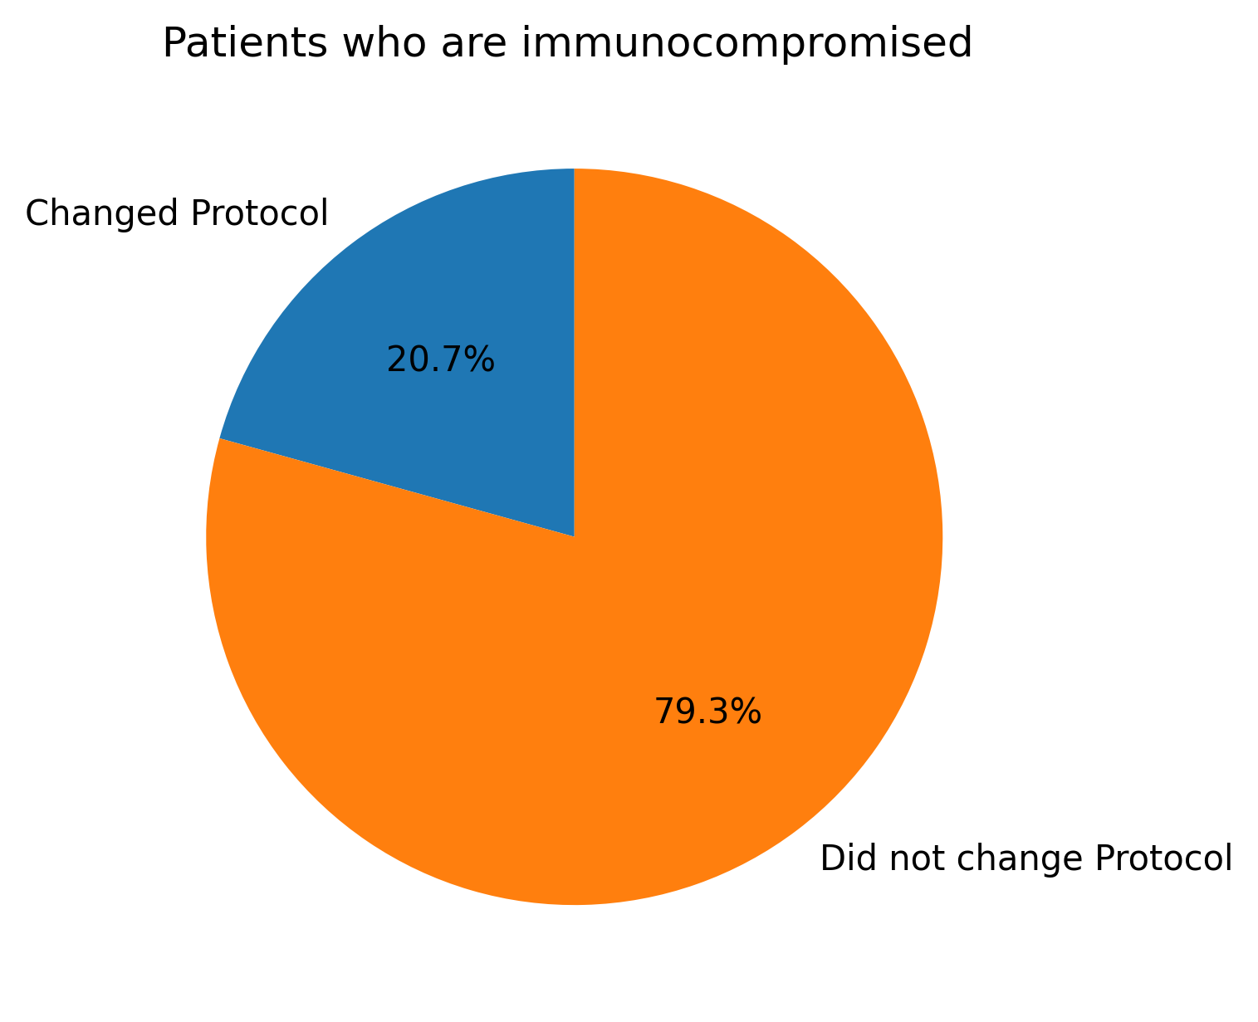
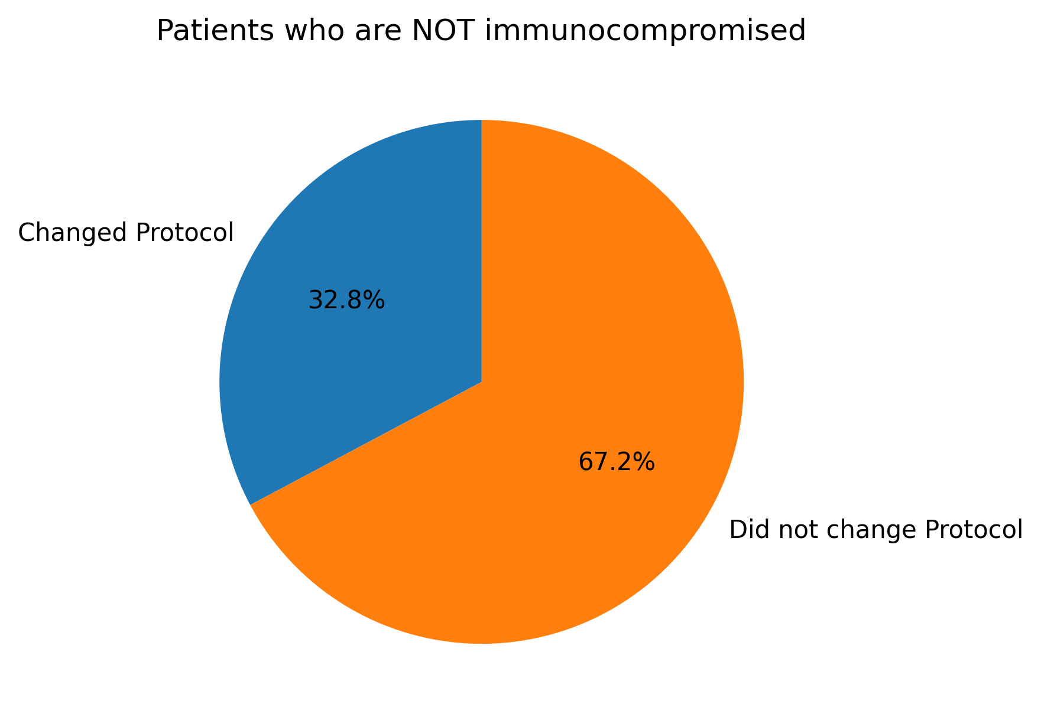
Does immunocompromised status affect whether the biopsy affected the antibiotic course?

Slide 13
Smoking n drinkin n shit

